Slide 1
AI / LLM-based Agents & Security

Slide 2





LLMs

Slide 3

LLMs & Agents
ChatGPT

Slide 4
LLMs & Agents
“Help me plan a 3-day trip to New York City.”
ChatGPT

Slide 5
LLMs & Agents
“Here’s a suggested itinerary:
Day 1: Visit Times Square, Central Park, and the MET.
Day 2: Explore the Statue of Liberty and the Brooklyn Bridge.
Day 3:…”
“Help me plan a 3-day trip to New York City.”
ChatGPT

Slide 6

LLMs & Agents
“Help me plan a 3-day trip to New York City.”
ChatGPT-based
Agent

Slide 7

LLMs & Agents
“Help me plan a 3-day trip to New York City.”
ChatGPT-based
Agent
Understanding

Slide 8




LLMs & Agents
“Help me plan a 3-day trip to New York City.”
ChatGPT-based
Agent
Understanding
(ChatGPT)
Data Retrieval
and Action

Slide 9

LLMs & Agents
“Help me plan a 3-day trip to New York City.”
ChatGPT-based
Agent
Understanding
(ChatGPT)
Data Retrieval
and Action
Plan Personalization

Slide 10

LLMs & Agents
“Help me plan a 3-day trip to New York City.”
ChatGPT-based
Agent
Understanding
(ChatGPT)
Data Retrieval
and Action
Monitor weather changes or
schedule conflicts and notify
with alternatives…
Updating
Plan Personalization

Slide 11
What is an Agent?
An AI/LLM-based agent can be defined as an application that attempts to achieve a goal by observing the world and acting upon it using the tools that it has at its disposal
Agents are autonomous and act independently of human intervention; they can reason about what they should do next to achieve the ultimate goal

Slide 12
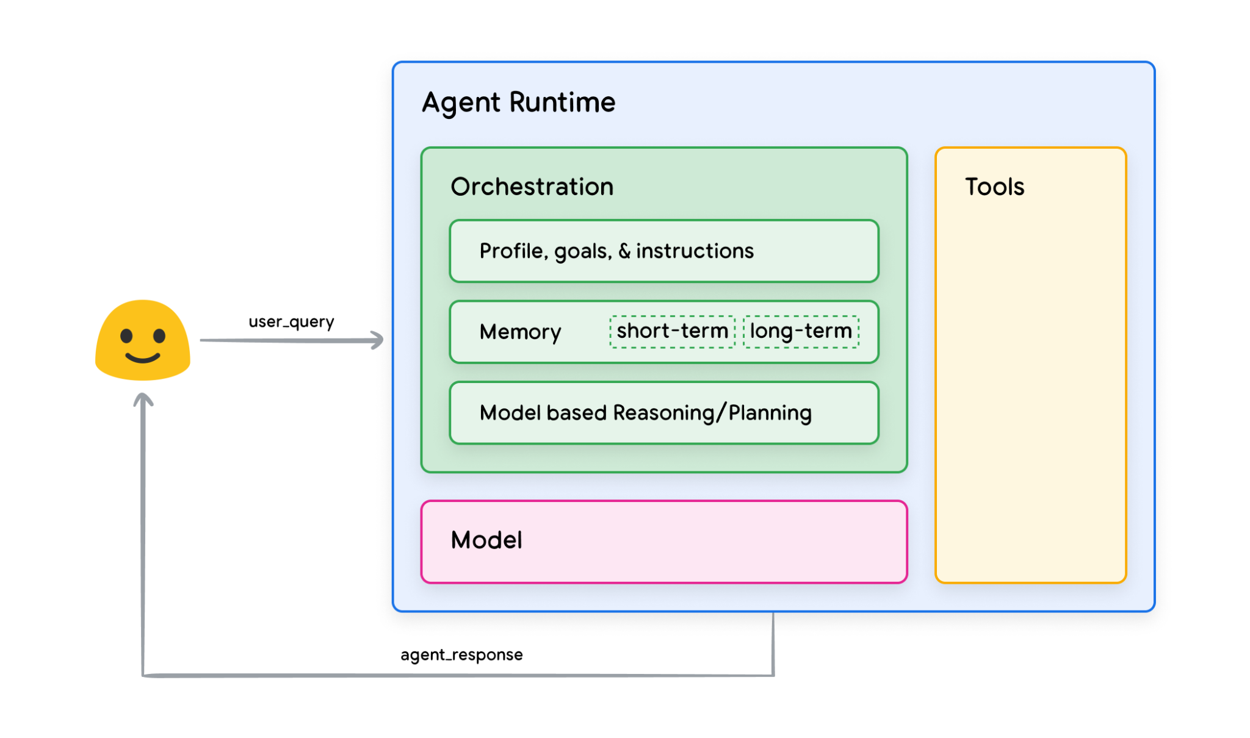
Foundational Components of an Agent
The foundational components that drive the agent’s behavior, actions, and decision making
Three essential components:
Model
Tools
Orchestration Layer
Google. Agents – white paper.

Slide 13
Foundational Components of an Agent
The Model:
Refers to the language model (LM) that will be utilized as the centralized decision maker for agent processes
The model in an agent can be one or multiple LM’s of any size that can instruction based reasoning and logic frameworks

Slide 14
Foundational Components of an Agent
The Tools:
Foundation models remain constrained by the inability to interact with the outside world
Tools bridge the gap, empowering agents to interact with external data and services
Typically align with web API methods
E.g., a tool can update customer information in a database or fetch weather data to influence a travel recommendation

Slide 15
Foundational Components of an Agent
The Orchestration Layer:
Describes a cyclical process that governs how the agent takes in information, performs internal reasoning, and then inform its next action or decision
In general, the loop will continue until the agent reaches its goal or a stop point

Slide 16
Capabilities of Agents
Tool Utilization
Advanced Reasoning
Tailored Generation
Levels of Autonomy
Integration with Other AI systems

Slide 17
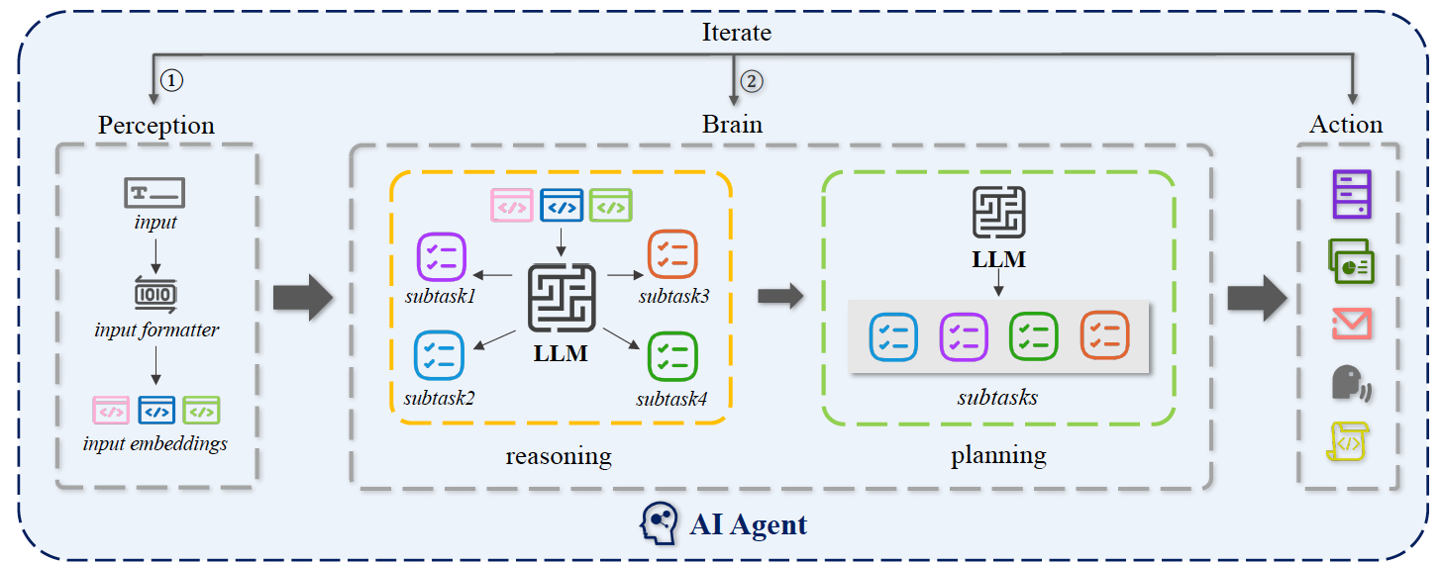
Conceptual Framework of AI Agent
Swinburne University of Technology. AI Agents Under Threat: A Survey of Key Security Challenges and Future Pathways.

Slide 18
Conceptual Framework of AI Agent
Notes:
Perception: enhance the quality of user input through prompt engineering

Slide 19
Conceptual Framework of AI Agent
Notes:
Reasoning refers to a large language model designed to analyze and deduce information, helping to draw logical conclusions from given prompts
Planning, on the other hand, denotes a large language model tailored to assist in making strategies and decisions by evaluating possible outcomes and optimizing for specific objectives.
The combination of LLMs for planning and reasoning is called the brain

Slide 20
Conceptual Framework of AI Agent
Notes:
External tool callings are together named as the action

Slide 21
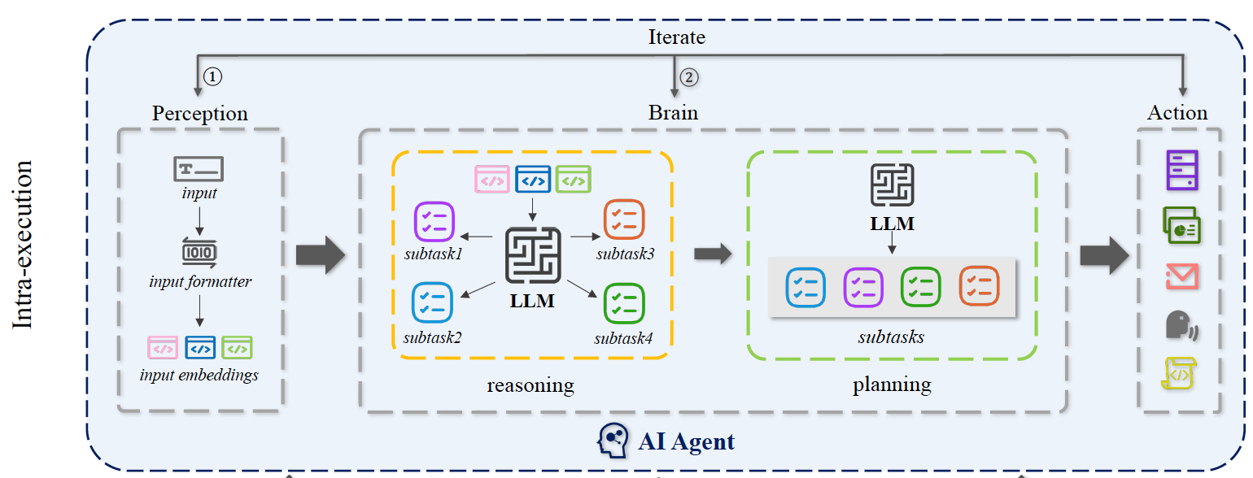
Conceptual Framework of AI Agent

Slide 22
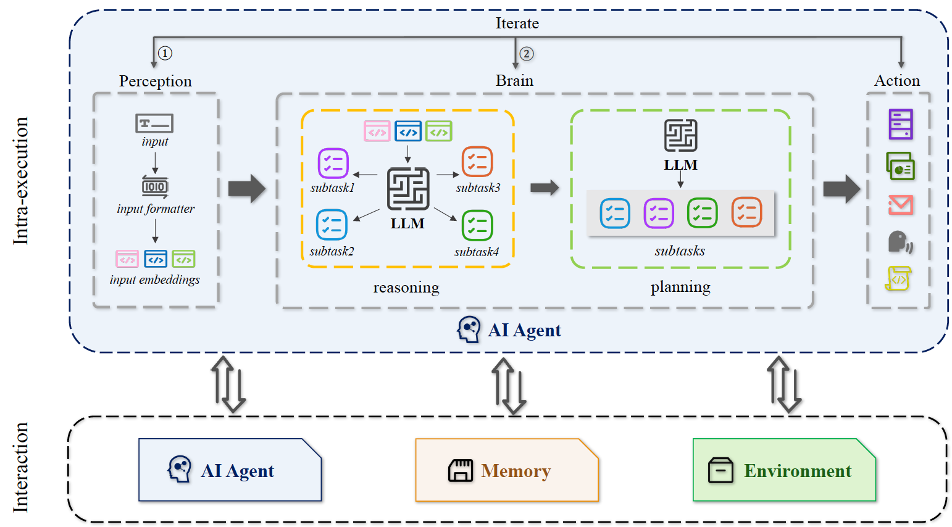
Conceptual Framework of AI Agent
Notes:
AI agents can interact with other agents, memories, and environments.
Specifically, the perception provides brain with effective inputs, and the action deals with these inputs in subtasks by the LLM reasoning and planning capacities.
Then, these subtasks are run sequentially by the action to invoke the tools. ① and ② indicates the iteration processes of the intra-execution.
Interaction refers to the ability of an AI agent to engage with other external entities, primarily through external resources.
This includes collaboration or competition within the multi-agent architecture, retrieval of memory during task execution, and the deployment of environment and its data use from external tools.
Note that in this survey, they define memory as an external resource because the majority of memory-related security risks arise from the retrieval of external resources.

Slide 23
The Security of AI Agent
AI agent security refers to
The measures and practices that protect agents from vulnerabilities and threats that could compromise their Functionality, Integrity, and Safety.
Ensuring the agents can securely handle user inputs, execute tasks, and interact with other entities without being susceptible to malicious attacks or unintended harmful behaviors

Slide 24
The Security Challenges in AI Agent
Four main knowledge gaps can cause security challenges:
Unpredictability of multi-step user inputs
Complexity in internal executions
Variability of operational environments
Interactions with untrusted external entities

Slide 25
The Security Challenges in AI Agent
Gap1: Unpredictability of multi-step user inputs
User inputs are highly diverse with different backgrounds and experiences. Also, it allows multi-step inputs.
When user inputs are inadequately described, such as
Insufficient specification
Harmful behaviors
Unsafe code execution
…

Slide 26
The Security Challenges in AI Agent
Gap2: Complexity in internal executions
The internal execution state of an AI agent is complex chain-loop structure, ranging from the reformatting of prompts to LLM planning tasks and the use of tools
The internal execution states are implicit and difficult to observe, so that the security issues cannot be detected in a timely manner

Slide 27
The Security Challenges in AI Agent
Gap3: Variability of operational environments
The development, deployment, and execution phases of many agents span across various environments
The variability can lead to inconsistent behavioral outcomes.

Slide 28
The Security Challenges in AI Agent
Gap4: Interactions with untrusted external entities
An agent’s crucial capability is to teach LLMs how to use tools and other agents
Other agents and external entities are assumed to be trusted

Slide 29
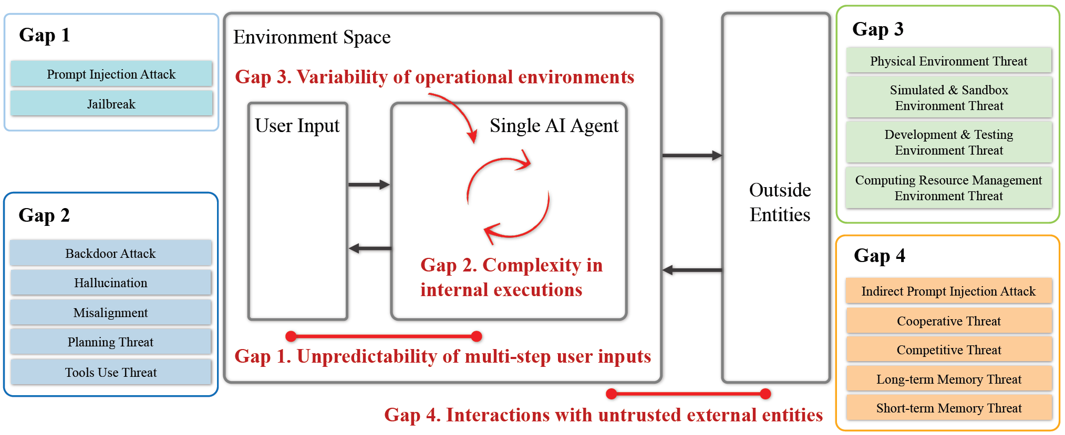
The Security Challenges in AI Agent

Slide 30
Conceptual Framework of AI Agent

Slide 31
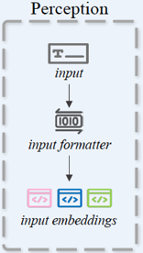
Threats on Perception
Perception module includes:
multimodal inputs
Textual
Visual
Auditory
multi-step
Initial user inputs
Intermediate sub-task prompts
Human feedback

Slide 32

Threats on Perception
Perception module includes:
multimodal inputs
Textual
Visual
Auditory
multi-step
Initial user inputs
Intermediate sub-task prompts
Human feedback
Adversarial attacks
Includes:
Prompt injection attacks
Indirect prompt attacks
Jailbreak attacks

Slide 33

Threats on Perception
Perception module includes:
multimodal inputs
Textual
Visual
Auditory
multi-step
Initial user inputs
Intermediate sub-task prompts
Human feedback
Adversarial attacks
Includes:
Prompt injection attacks
Indirect prompt attacks
Jailbreak attacks
Harmful response,
prompt leakage, …

Slide 34


Threats on Perception
Perception module includes:
multimodal inputs
Textual
Visual
Auditory
multi-step
Initial user inputs
Intermediate sub-task prompts
Human feedback
Adversarial attacks
Includes:
Prompt injection attacks
Indirect prompt attacks
Jailbreak attacks

Slide 35
Threats on Perception
Perception module includes:
multimodal inputs
Textual
Visual
Auditory
multi-step
Initial user inputs
Intermediate sub-task prompts
Human feedback
Adversarial attacks
Includes:
Prompt injection attacks
Indirect prompt attacks
Jailbreak attacks
Remote code execution (RCE) to acquire permissions for integrated applications
Generate and execute malicious SQL queries
Leave biases towards products on the corresponding webpages
…

Slide 36
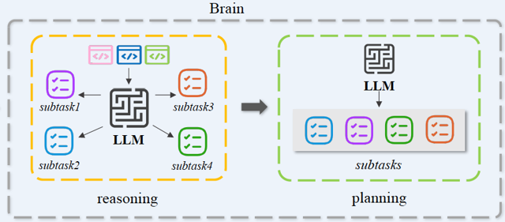
Threats on Brain
Brain
primarily composed of an LLM
Structure
Reasoning. CoT, ToT,…
Planning. Making structured plan for each subtask
Decision-making. LLMs within the agent make the decision to select tools

Slide 37
Threats on Brain
Brain is NOT transparent
Backdoor?
In the model or any intermediate reasoning stage
E.g., always send phishing emails to people from UB
Misalignment?
Training data, human-agent, embodied environments
Hallucination?
Erroneous Planning?*
…
*The Hong Kong University of Science and Technology. Testing and Understanding Erroneous Planning in LLM Agents through Synthesized User Inputs.
Notes:
CoT can be error amplifier. Testing and Understanding Erroneous Planning in LLM Agents through Synthesized User Inputs

Slide 38
Threats on Action
Actions include:
Action input. The message created by the agent’s brain indicates how the selected tool is used
Action execution. The tool executes subtasks based on the action input
Observation. Return message for the tool’s use outcome
Final answer. An outcome message indicating the finished state of action

Slide 39
Threats on Action
Two types of threats:
Agent2Tool threats
Active. Threats in action input provided by LLMs
E.g., The action execution requires excessive tool permissions, leading to the execution of highly risky commands without user permission.*
Passive. Threats in interception of observations and final answers
HuggingGPT and ToolFormer suffered user privacy breaches
Supply chain threats
The security vulnerabilities inherent in the tools
*University of Toronto. Identifying the Risks of LM Agents with an LM-Emulated Sandbox.

Slide 40
Interaction Security
Agent2Environment threats
Simulated & Sandbox Environment
Development & Testing Environment
Fine-tuning or deploy 3rd–party LLMs
Testing focus on a few components instead of the whole agent
Computing Resources Management Environment
Resource exhaustion attack. Like DoS
Inefficient resource allocation
Insufficient isolation between agents
Unmonitored resource usage. Anomalous behaviors
Physical Environment
Hardware
Database & Knowledge base

Slide 41
Interaction Security
Agent2Agent threats
Cooperative Interaction Threats
Agents can secretly collude through their public communication, making their seemingly independent actions work together to create systemic bias
Frequent cooperation can amplify minor hallucination*
One agent’s error or misleading information can quickly spread to others. (worm Morris II$)
Competitive Interaction Threats
Can cause fraud, election tampering, and loss of control over AI systems
*University of Toronto. MetaGPT: Meta Programming for A Multi-Agent Collaborative Framework.
$Here Comes The AI Worm: Unleashing Zero-click Worms that Target GenAI-Powered Applications

Slide 42
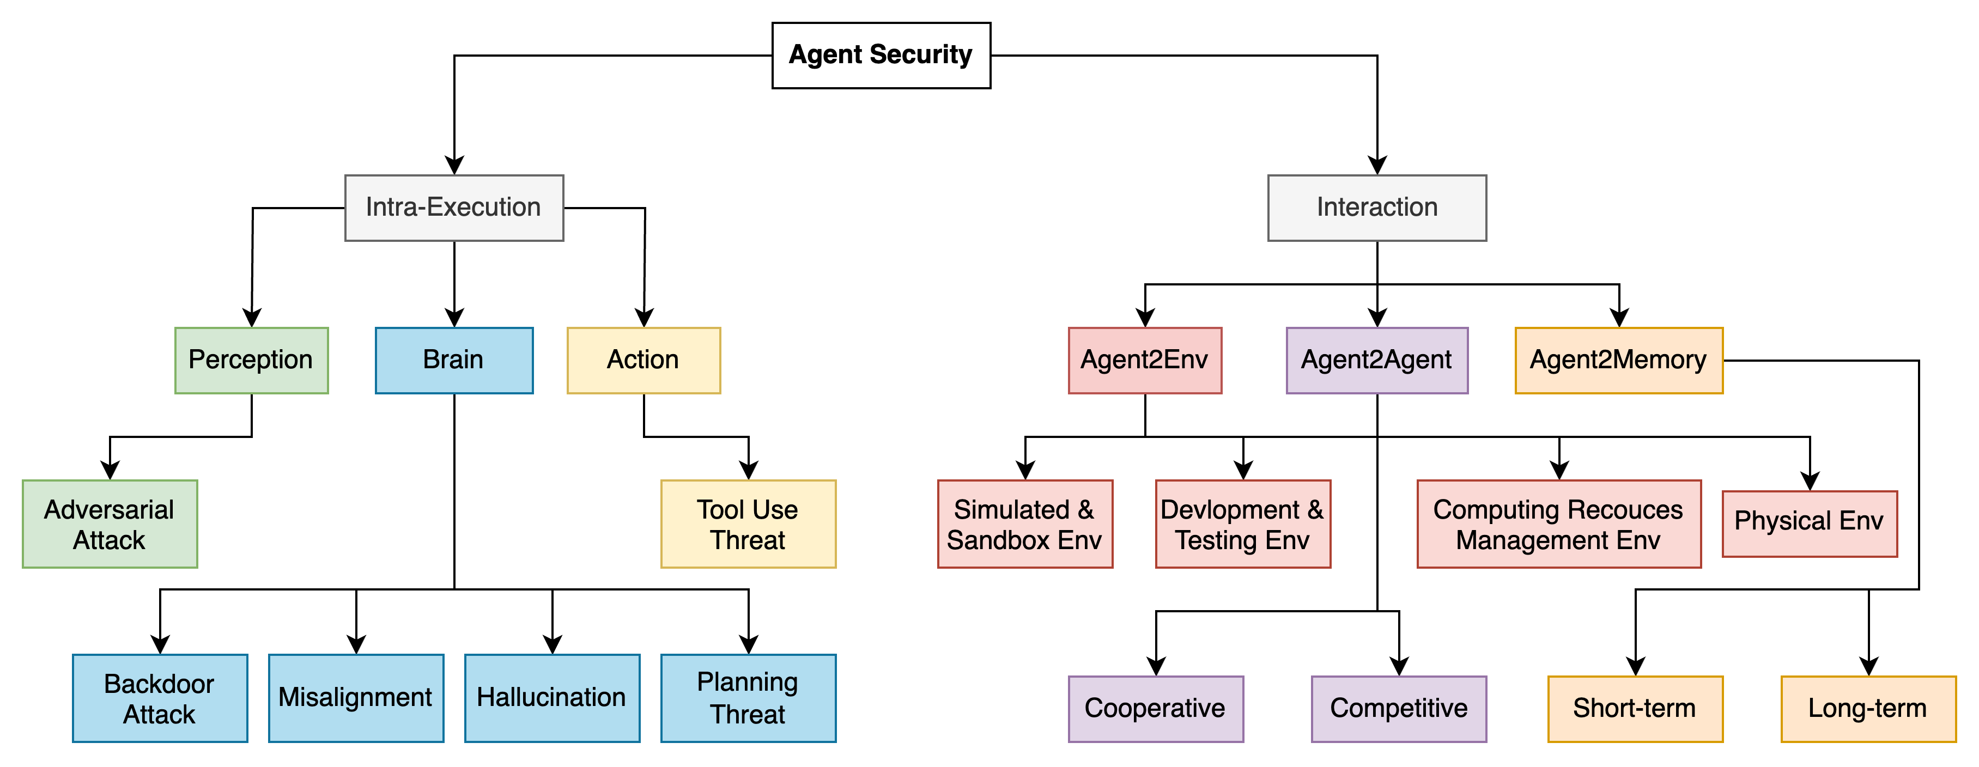

Slide 43
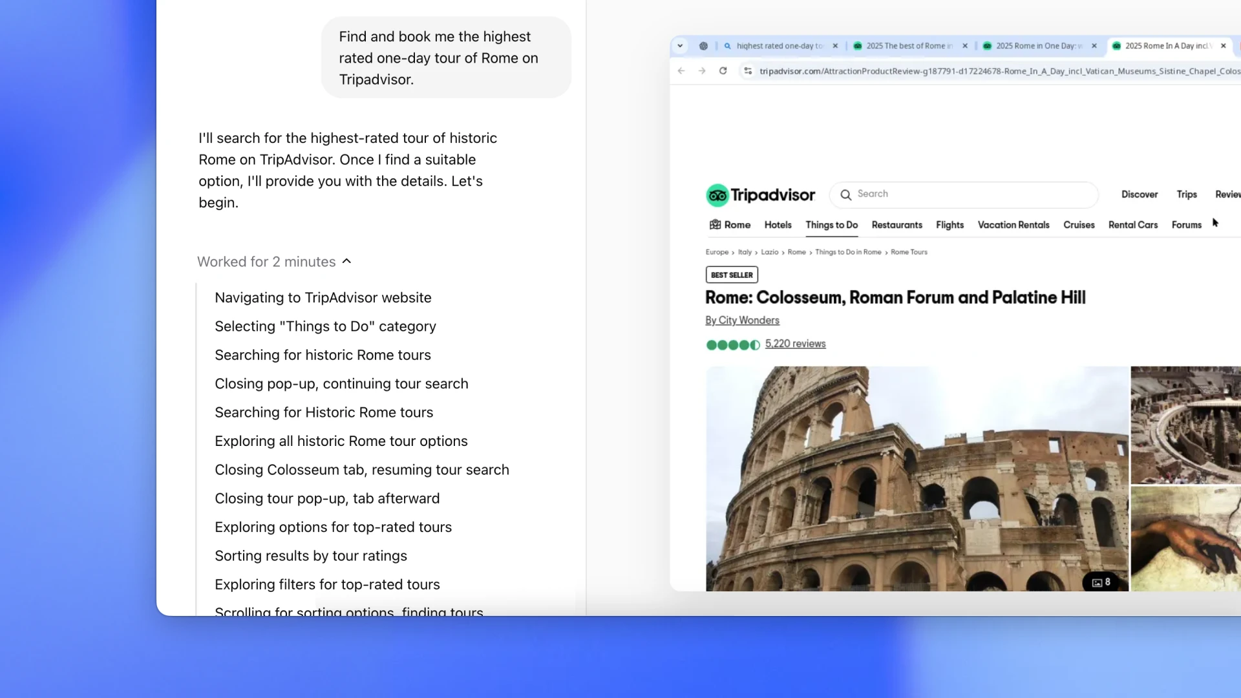
Open AI Operator
An agent that can use its own browser to perform tasks for you
E.g., Filling forms, ordering groceries, creating memes…
OpenAI. Introducing Operator. https://openai.com/index/introducing-operator/

Slide 44
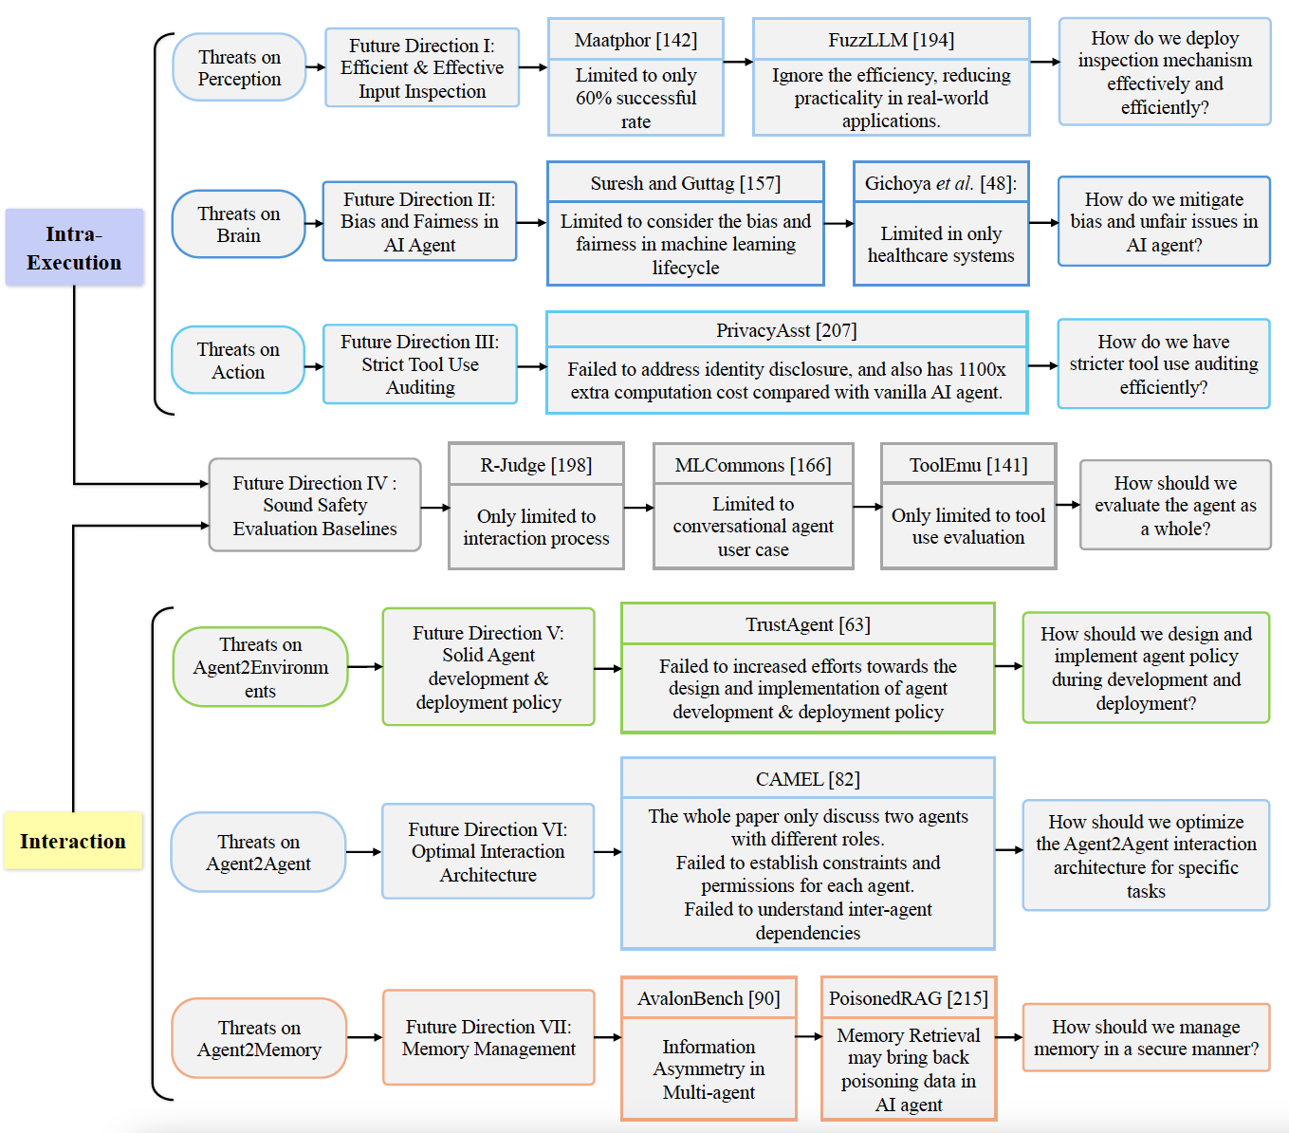

Slide 45
Tools
Three primary types of tools that Google models are using:
Extensions
Functions
Data Stores

Slide 46
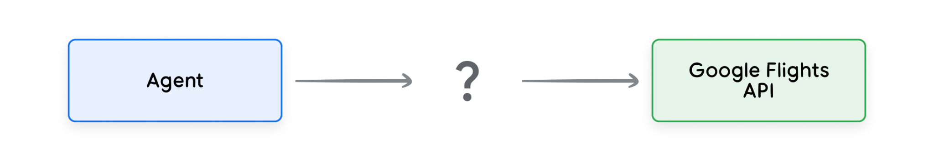
Tools
Directly call a third-party API?
“I want to book a flight from New York to Buffalo”

Slide 47
Tools
Directly call a third-party API?
“I want to book a flight from New York to Buffalo”

Slide 48
Tools
Directly call a third-party API?
“I want to book a flight from New York to Buffalo”

Slide 49
Tools
Directly call a third-party API?
“I want to book a flight from New York to Buffalo”

Slide 50
Tools
Directly call a third-party API?
“I want to book a flight to Buffalo”

Slide 51
Tools
Directly call a third-party API?
“I want to book a flight to Buffalo”
The API call would fail without the required data
More code would need to catch edge and corner cases
Not scalable

Slide 52
Tools
Extension:
Bridges the gap between an agent and an API by:
Teaching the agent how to use the API endpoint using examples
Teaching the agent what arguments or parameters are needed

Slide 53
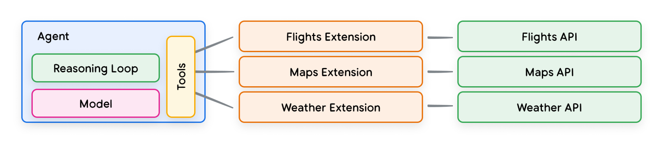
Tools
Extension:
An agent uses the model and examples at run time to decide which Extension to be use.

Slide 54
Functions
A model can take a set of known functions and decide when to use each Function and what arguments it needs.
Functions vs Extensions:
A model outputs a Function and its arguments, but doesn’t make a live API call
Functions are executed on the client-side, while Extensions are executed on the agent-side

Slide 55
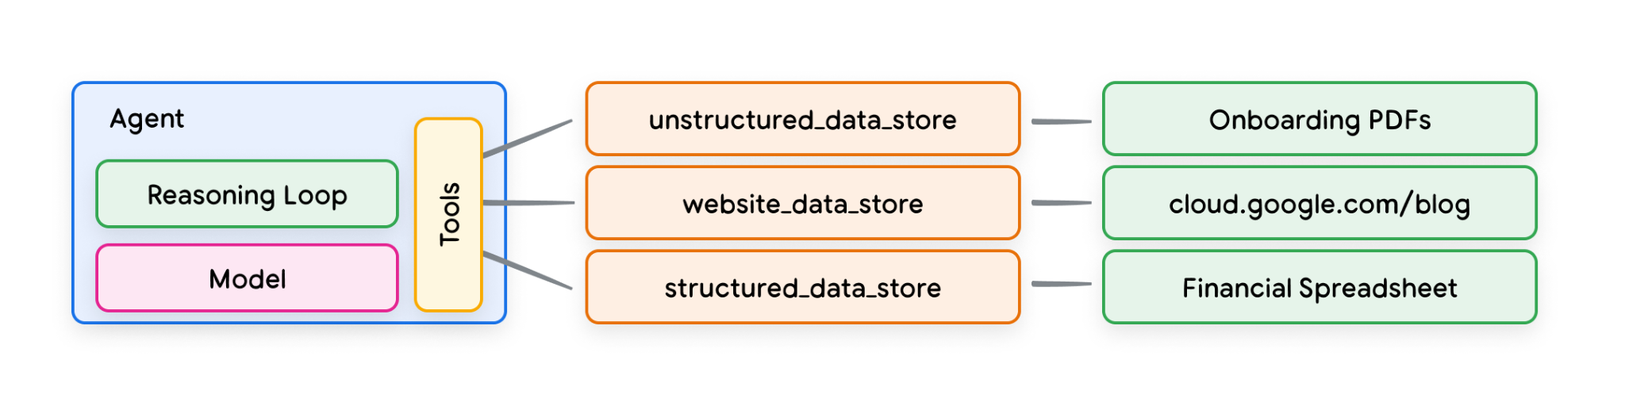
Data Store
Data stores allow developers to provide additional data in its original format to an agent, eliminating the need for time-consuming data transformation, model retraining, or fine-tuning.
It converts the incoming document into a set of vector database embeddings that the agent can retrieval the information it needs.
Retrieval Augmented Generation (RAG) based application

